Slide 1
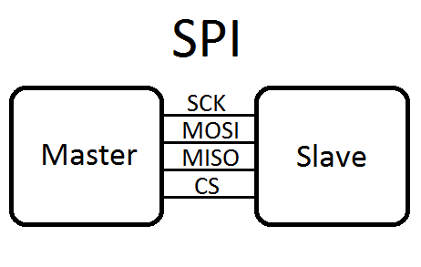
Linux SPI Driver

Slide 2
Agenda
Introduct SPI protocol
Linux SPI concepts
Implement SPI protocol driver
Demo SPI driver with LCD Nokia 5110

Slide 3
Introduction to SPI protocol
What's SPI ?
Common uses of SPI
SPI signals
SPI Modes
Timing diagram
SPI can be more complicated

Slide 4
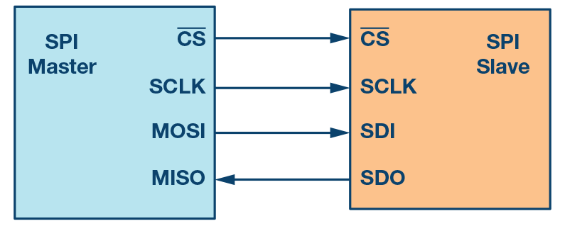
What's SPI ?
Stand for Serial Peripheral Interface
Protocol uses 4 wire signals
Designed by Motorola
Master mode and Slave mode
No maximum clock speed

Slide 5
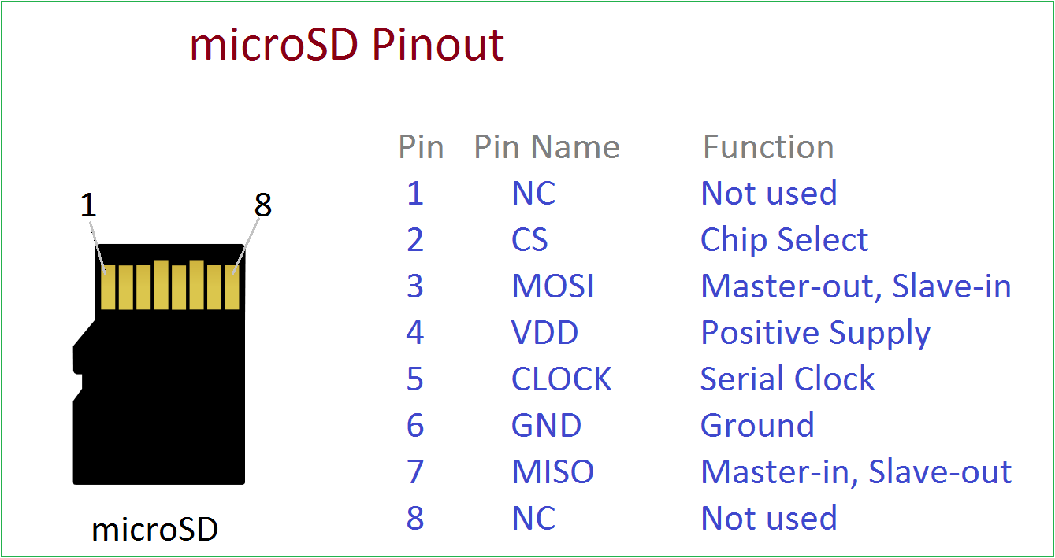
Common uses of SPI
Flash memory
ADCs
LCD controllers
Sensors
MCUs

Slide 6
SPI signals
CS: chip select
SCLK: Clock
MOSI: Master out Slave in
MISO: Master in Slave out

Slide 7
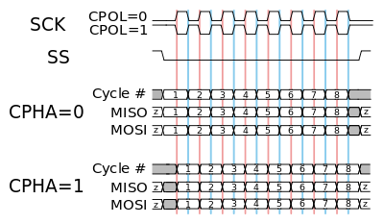
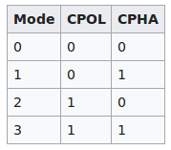
SPI Modes

Slide 8
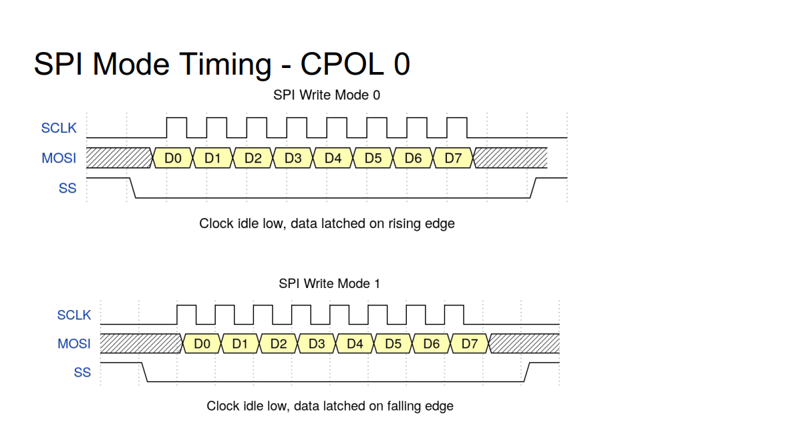
Timing diagram

Slide 9
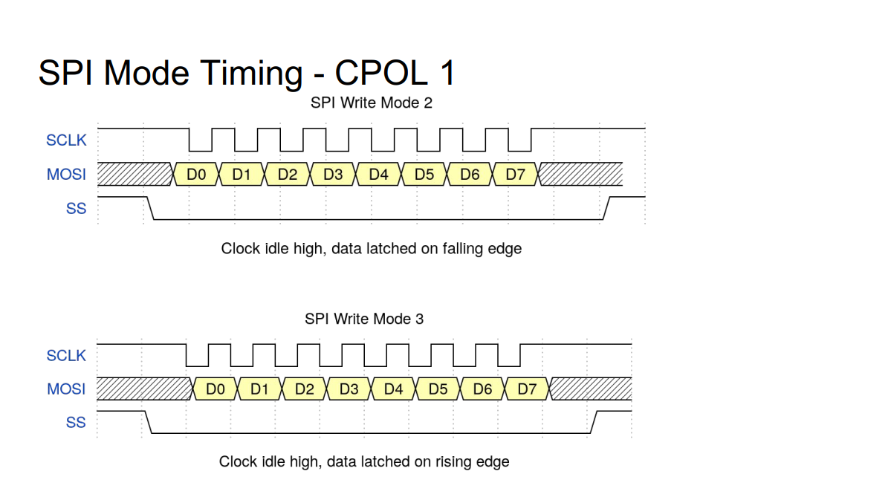
Timing diagram

Slide 10
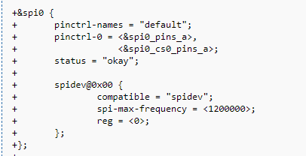
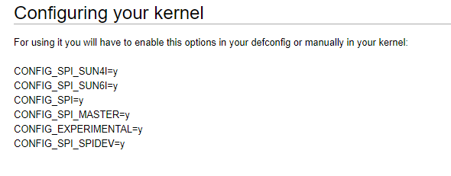
Linux SPI concepts
Linux SPI drivers
Controller Driver - Bus driver
Protocol Driver - Device driver
User-space Driver - spidev

Slide 11
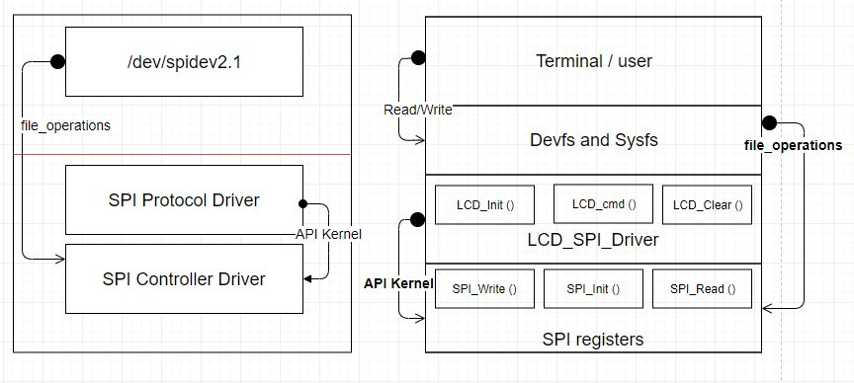
Linux SPI concepts

Slide 12
Implement SPI protocol driver
SPI protocol driver
Device tree.
Register struct spi_driver with kernel.

Slide 13
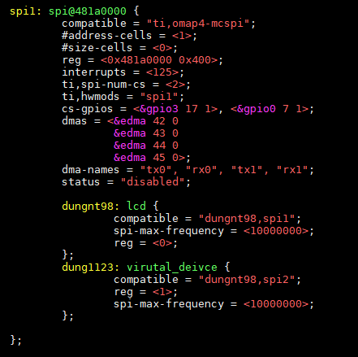
Implement SPI protocol driver
Device tree
Add new device node into Device tree.
Device tree will be parsed when controller driver call to function spi_register_controller

Slide 14
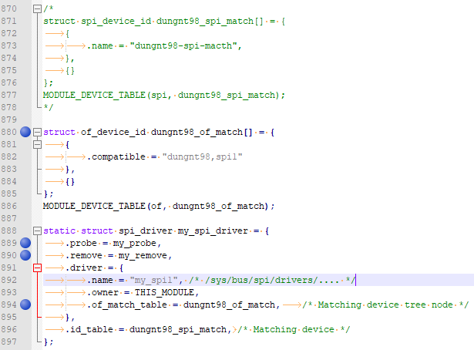
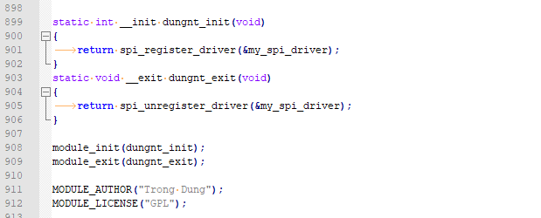
Implement SPI protocol driver
SPI protocol driver
Register struct spi_driver with kernel.

Slide 15
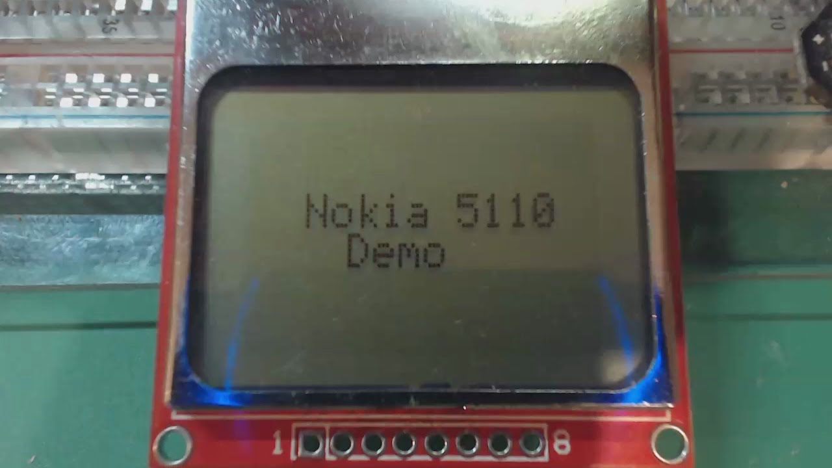
Demo SPI driver with LCD Nokia 5110
Protocol driver - Nokia 5110 driver

Slide 16
References
http://linux-sunxi.org/SPIdev
http://events17.linuxfoundation.org/sites/events/files/slides/Groking%20the%20Linux%20SPI%20Subsystem.pdf
https://en.wikipedia.org/wiki/Serial_Peripheral_Interface#Mode_numbers
https://elixir.bootlin.com/linux/v4.14.108/source/Documentation/spi

Slide 17

Thanks for watching

